Slide 1
WEB222
DOM in Detail & Event handling

Slide 2
Announcements
Assignment Due (check blackboard)

Slide 3
Agenda
Part One
Quick Introduction to "onclick"
Document Object Model (DOM)
DOM Tree, Node Explained
Part Two
Selecting Elements
Creating Nodes / Modifying the DOM Tree
DOM Events

Slide 4
Part 1
Quick Introduction to "onclick"
Document Object Model (DOM)
DOM Tree, Node Explained

Slide 5
Responding to events with "onclick"
Before we begin studying the DOM in detail, it is important that we discuss the "onclick" element attribute, as many of the examples in this lecture use it.
Adding the onclick="someFunction()" attribute is a simple way to call a JavaScript function when the corresponding element has been clicked by the user, for example:
HTML
JavaScript
<button type="button" onclick="sayHello()">Hello</button>
function sayHello() {
console.log("Hello");
}

Slide 6
The Document Object Model (DOM)
Recall: The Document Object Model (DOM) is an 2-way application programming interface (API) for HTML (and XML) documents.
It defines how the document structure, style and content can be accessed and manipulated.
It provides a structured representation of the document.
With the DOM, programmers can build documents, navigate their structure, and add, modify, or delete elements and content using JavaScript or other languages.

Slide 7
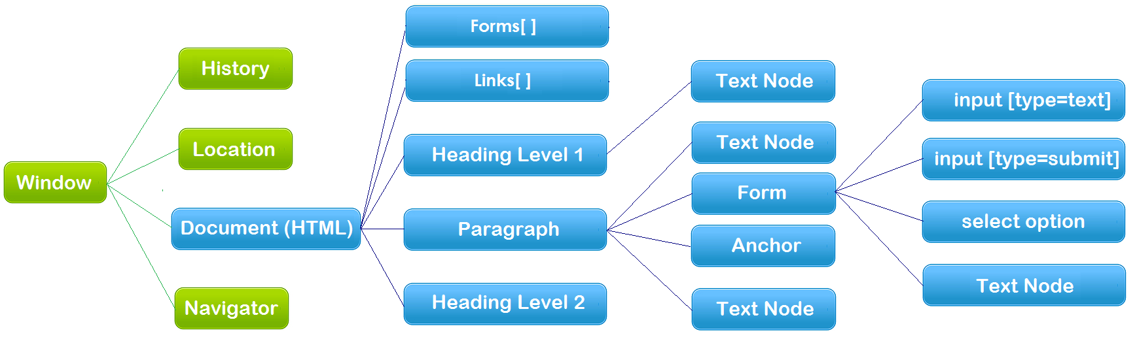
The Document Object Model (DOM)
An example of the hierarchy of the Document Object Model (blue)
Document – HTML Document/file
API – each node above is an object that has properties and methods

Slide 8
document Object
An HTML document loaded into a browser window becomes a document object.
The document object provides access to all HTML elements in a page, from within a script.
The document object is also part of the Window object, and can be accessed through the window.document property.

Slide 9
document Object
Document object methods – get/query element(s):
document.getElementsByName()
document.getElementsByClassName()
document.getElementsByTagName()
document.querySelector()
Returns the first element that matches a specified CSS selector(s) in the document
document.querySelectorAll()
Returns a static NodeList (array) containing all elements that matches a specified CSS selector(s) in the document
Examples:
var paras = document.getElementsByTagName("p");
var example = document.querySelector("p.example");

Slide 10
document Object
document object properties and methods:
document.createElement()
document.createTextNode()
document.createAttribute()
document.createComment()
document.addEventListener()
Example: create-element.html

Slide 11
The DOM Tree
When a HTML document is loaded, the browser creates a Document Object Model.
The DOM represents a document as a tree.
<!doctype html>
<html>
<head>
<meta charset="UTF-8" />
<title>This is a Document!</title>
</head>
<body>
<h3>Welcome!</h3>
<p>This is a paragraph.</p>
<p>This is a paragraph with a <a href="index.html">link</a> in it.</p>
<ul>
<li>first item</li>
<li>second item</li>
<li>third item</li>
</ul>
</body>
</html>

Slide 12
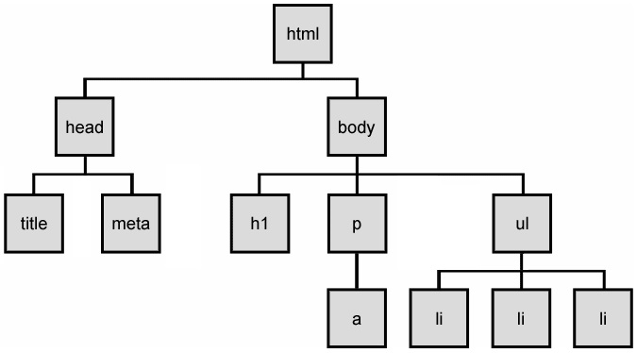
The DOM Tree
The HTML elements of the page are nested into a tree-like structure of objects.
The tree is made up of parent-child relationships, a parent can have one or many children elements.
Example: dom-tree.html

Slide 13
HTML DOM Nodes
A document is a structure of nodes.
Everything in an HTML DOM is a node.
window.document, each element,
attributes and text inside elements are nodes,
DOCTYPE, comments, whitespaces are also nodes.
All these DOM objects inherit from a node object, which provides properties and methods (ie: Web API Interfaces)
DOM document object
DOM Element objects
DOM Attribute objects
DOM Event object

Slide 14
Document Object Model (DOM)
HTML documents are made up of HTML elements
In the HTML DOM, every HTML element is represented by an element object (node).
Types of DOM nodes
element nodes (HTML tag)
For each HTML element, there is a node object. It can have children and/or attributes
text nodes (text in an element)
attribute nodes (attribute/value pair)
text/attributes are children in an element node
cannot have children or attributes
not usually shown when drawing the DOM tree

Slide 15
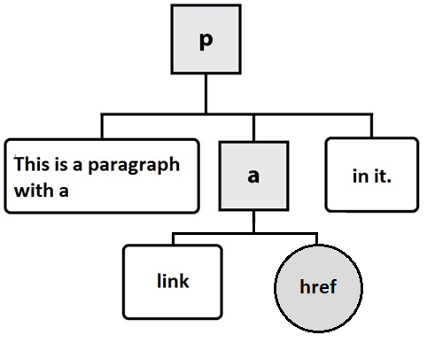
At the Ends of DOM Tree
HTML
DOM nodes
element nodes
text nodes
attribute nodes (not typically drawn)
<p>This is a paragraph with a <a href="index.html">link</a> in it.</p>

Slide 16
Element Nodes/Objects
Properties and Methods of element nodes/objects – the standard API
Properties:
Methods:
Reference: The HTML DOM Element Object
element.className
element.id
element.style
element.innerHTML
element.parentNode
element.nextSibling
…
element.getElementsByTagName()
element.getElementsByClassName()
element.querySelector()
element.querySelectorAll()
element.addEventListener()
element.appendChild()
element.insertBefore()
element.removeChild()
element.setAttribute()
element.getAttribute()

Slide 17
Example
Highlight all paragraphs within a div element:
HTML:
Example: node-elements.html
JavaScript:
<p>Mail to: </p>
<div id="address">
<p>70 The Pond Road</p>
<p>Toronto, ON</p>
</div>
var elem = document.querySelector("#address").;
var addrParas = elem.getElementsByTagName("p");
// highlight all paragraphs inside the div element
for (var i = 0; i < addrParas.length; i++) {
addrParas[i].style.backgroundColor = "yellow";
}

Slide 18
Part 2
Selecting Elements
Creating Nodes / Modifying the DOM Tree
DOM Events

Slide 19
Methods for selecting elements
Selecting groups of elements within an element object, including document object
name | description
getElementsByTagName() | Returns a collection of all child elements with the specified tag name
getElementsByClassName() | Returns a collection of all child elements with the specified class name
querySelector() | Returns the first element that matches the selector specified in the parameter
querySelectorAll() | Returns a static (non-live) NodeList (array) of all elements that match the selector specified in the parameter. NOTE: by "non-live" we mean that the array will not reflect changes to the element list based on the addition / subtraction of new nodes. It's more of a "snapshot" of elements.

Slide 20
Creating New Nodes
NOTE: This merely creates a node; it does not add it to the page
You must add the new node as a child of an existing element on the page, ie:
name | description
document.createElement("tag") | creates and returns a new empty DOM node representing an element of that type
document.createTextNode("text") | creates and returns a text node containing given text
// create a new <h2> node
var newHeading = document.createElement("h2");
var t = document.createTextNode(" This is a heading ");
newHeading.appendChild(t);
newHeading.style.color = "blue";
document.body.appendChild(newHeading);

Slide 21
Modifying the DOM tree
Every DOM element object has these methods:
Examples:
node_appendChild.html
node_insertBefore.html
node_removeChild.html
node_replaceChild.html
name | description
appendChild(node) | places given node at end of this node's child list
insertBefore(new, old) | places the given new node in this node's child list just before old child
removeChild(node) | removes given node from this node's child list
replaceChild(new, old) | replaces given child with new node

Slide 22
Modifying element / node attributes
name | description
hasAttribute(name) | checks if the attribute exists
getAttribute(name) | gets an attribute value
setAttribute(name, value) | sets an attribute
removeAttribute(name) | removes an attribute

Slide 23
Modifying element / node attributes
Example 1 (Modifying element / node attributes)
Example 2:
var elem = document.querySelector("#d1");
elem.setAttribute("class", "notes");
// or simply: elem.class = "notes";
document.querySelector("#image").height = "200";
document.querySelector("#image").src="pic2.jpg";

Slide 24
innerHTML Property
Example – 2-way API: innerHTML2.html
As we have seen in earlier lectures, the innerHTML property can be used to add elements / objects into a web page. e.g.
However: Creating elements like this breaks our separation of concerns and can be error prone.
It is for this reason that we typically use the createElement(), createTextNode(), appendChild(), setAttribute(), etc. methods for creating complex elements in the DOM.
document.querySelector("#xy12").innerHTML += "<p style='color: red; " +
"margin-left: 50px;' " +
"onclick='myOnClick();'>" +
"A paragraph!</p>";

Slide 25
Events
In general everything that happens in a browser may be called an event.
e.g. an event occurs when a user clicks on a link or a button in a form
Every element on a web page has certain events which can trigger a JavaScript function.
JavaScript needs a way of detecting user actions so that it knows when to react.
It also needs to know which functions to execute.

Slide 26
Common Events
Events triggered by user actions.
e.g.
When a user clicks the mouse
When a user presses a key
When the mouse moves over an element
When an input field is changed
When an HTML form is submitted
Events that are not directly caused by the user.
e.g.
When a web page has finished loading
When an image has been loaded
Full List Includes:
Mouse events, keyboard events, HTML frame/object events, HTML form events, user interface events, touch events, etc…

Slide 27
Event Handlers
Event Handlers are used to manipulate documents.
An event handler is used in order to execute a script when an event occurs.
The event handler has a prefix "on" followed by the event name.
For example, as we have seen: the event handler for the click event is onclick.
<button onclick="myFunction()">Click me</button>

Slide 28
Creating Event Handlers
General syntax:
<htmltag id="someId" eventHandler="JavaScript Code">
e.g.
Note:
The event handlers in HTML must be enclosed in quotation marks.
Alternate double quotation marks with single quotation marks to pass strings to your functions:
eg.
<input type="button" value="New Button!" onclick="console.log('some text');" />
<input type="button" value="New Button!" onclick='console.log("some text")' />

Slide 29
Creating Event Handlers – Using DOM
The HTML DOM allows you to create an event object for a specific element using JavaScript
This is a better solution, as it helps to separate structure & behaviour (no "on" events in our structure (HTML))
Example: js-event-init.html
<script>
function displayDate() {
document.querySelector("#demo").innerHTML = (new Date()).toLocaleString();
}
window.onload = function() { // why use window.onload?
var elem = document.querySelector("#myBtn");
elem.onclick = displayDate;
// elem.addEventListener( "click", displayDate ); // also works
};
</script>

Slide 30
Event Handler Examples - onmouseout
onmouseout:
Occurs when the user has rolled the mouse out of an element.
Applies to:
Any HTML element
Example: js-onmouseout.html

Slide 31
Event Handler Examples - onmouseover
onmouseover:
Occurs when the user has rolled the mouse on top of an element.
Applies to:
Any HTML element
Example: js-onmouseover.html

Slide 32
Event Handler Examples - onresize
onresize:
Occurs when the user has resized a window or object.
Applies to:
<body> (window)
Example: js-onresize.html

Slide 33
Event Handler Examples - onbeforeunload
onbeforeunload :
The onbeforeunload event fires when the document is about to be unloaded.
Applies to:
(window)
Example: js-onbeforeunload.html
NOTE: Developers used to be able to set a custom message to this dialog by returning a string from the function – however this has been since removed in most browsers in favour of a "generic" warning message.

Slide 34
Timer Events
method | description
setTimeout(function, delayMS); | arranges to call given function after given delay in ms
setInterval(function, delayMS); | arranges to call function repeatedly every delayMS ms
clearTimeout(timerID); clearInterval(timerID); | stops the given timer so it will not call its function
The first 2 methods return timerID which can be used to stop the timer by using the last 2 methods.
E.g:
<button onclick="setInterval(function(){console.log('Hello')},3000);"> Try it</button>

Slide 35
Helpful Resource Links
MDN: Introduction to DOM
MDN: DOM Examples
MDN: Creating New Elements
JavaScript Kit: DOM Reference
W3C: Handling events with JavaScript

Slide 36
Questions?
Any questions?
Would you like to see any more examples?

